Slide 1
Singular Value Decomposition(SVD)
BackGround Work

Slide 2
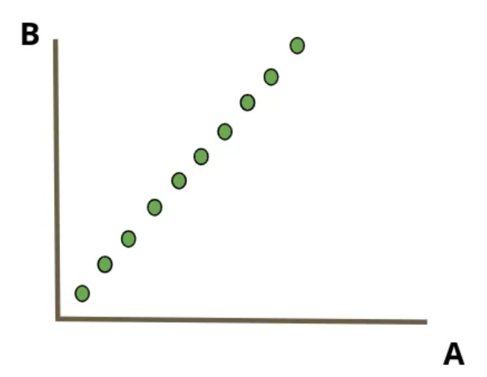
Singular Value Decomposition(SVD)
Consider trying to predict the number of people biking to work given two features A and B. Ideally, what would we want the relationship between A and B to look like? What happens if they are perfectly linearly related as such:

Slide 3
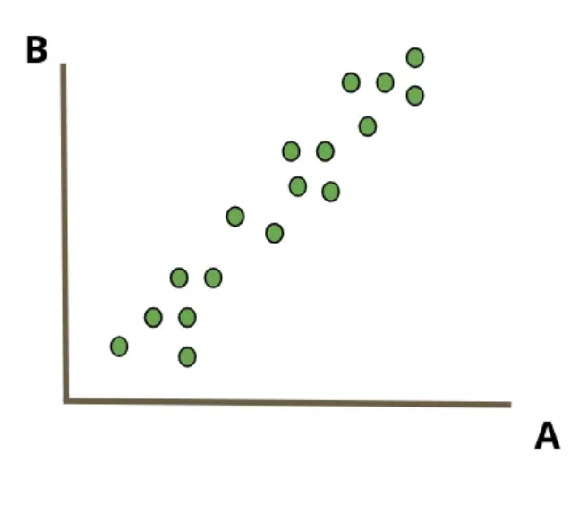
Singular Value Decomposition(SVD)
Consider a large dataset of users where the first feature is the user’s age, the second feature is the user’s age multiplied by 2, the third feature is the user’s age multiplied by 3 and so on. Most of that dataset is redundant since all the information is contained in that first feature. So while the matrix containing all this data may be high-dimensional, the effective dimension (or rank of the matrix) is very low.
In practice, it’s rare to have perfectly linearly dependent features as above. There is usually some variation around that linear relationship:

Slide 4
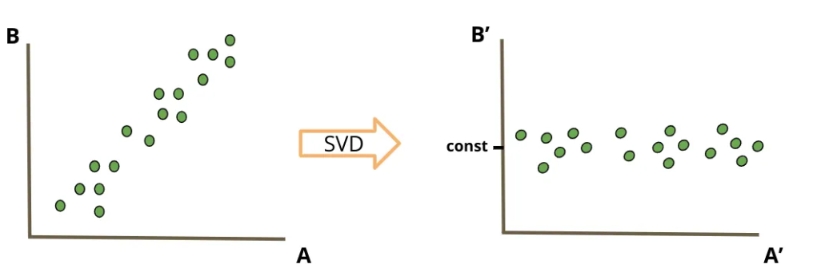
Singular Value Decomposition(SVD)
Now the dimension of the data matches the rank (i.e. the matrix of our features is full rank) but this is still not a desirable relationship to have between A and B. Although you cannot predict exactly what B will be for any A, you know that if A increases you can expect to see an increase in B.

Slide 5
Singular Value Decomposition(SVD)
The Singular Value Decomposition (SVD) algorithm is typically used for numerical data in linear algebra, but it can be adapted to handle categorical data through various preprocessing techniques. SVD decomposes a matrix into three other matrices, making it useful for tasks like dimensionality reduction, noise reduction, and data compression. However, to apply SVD to categorical data, the categorical variables need to be converted into a numerical format. One common method for this conversion is one-hot encoding.

Slide 6
Singular Value Decomposition(SVD)
Steps to Apply SVD to Categorical Data:
Convert Categorical Data to Numerical Format:
Use one-hot encoding to convert categorical variables into binary vectors.
Construct a Matrix:
Create a matrix where rows represent samples and columns represent the one-hot encoded features.
Apply SVD:
Decompose the matrix using SVD.

Slide 7
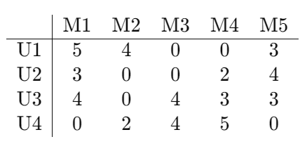
Singular Value Decomposition(SVD)
Example: Movie Recommendations
Steps to Use SVD for Movie Recommendations
Data Collection: Create a user-item interaction matrix where rows represent users, columns represent movies, and entries represent ratings.
For example, let's consider a small dataset with ratings from four users (U1, U2, U3, U4) for five movies (M1, M2, M3, M4, M5):

Slide 8
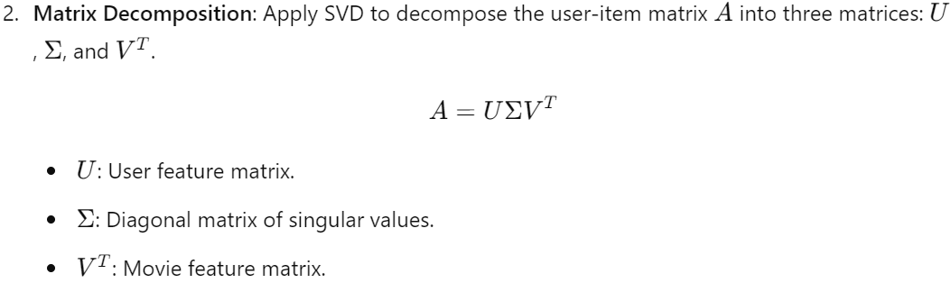
Singular Value Decomposition(SVD)

Slide 9
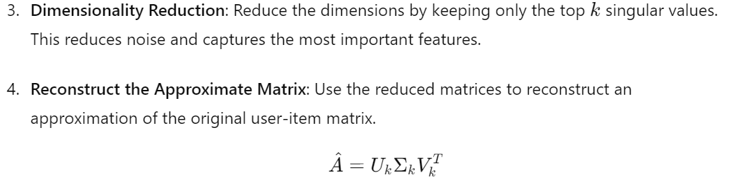
Singular Value Decomposition(SVD)

Slide 10
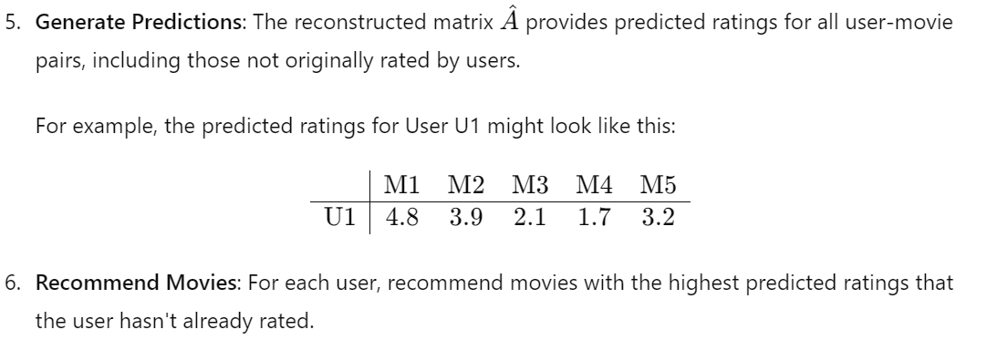
Singular Value Decomposition(SVD)

Slide 11
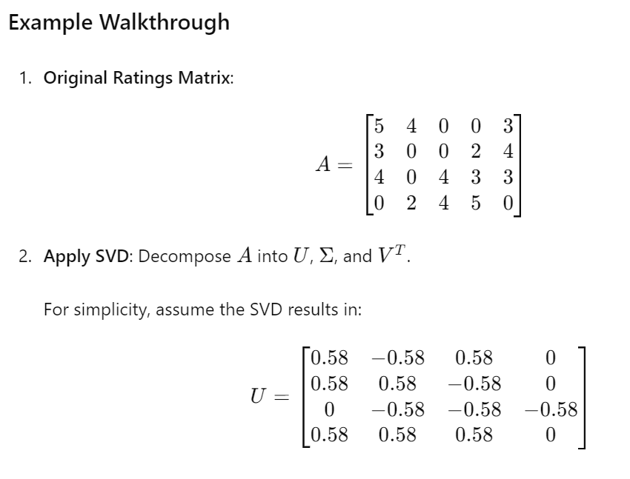
Singular Value Decomposition(SVD)

Slide 12
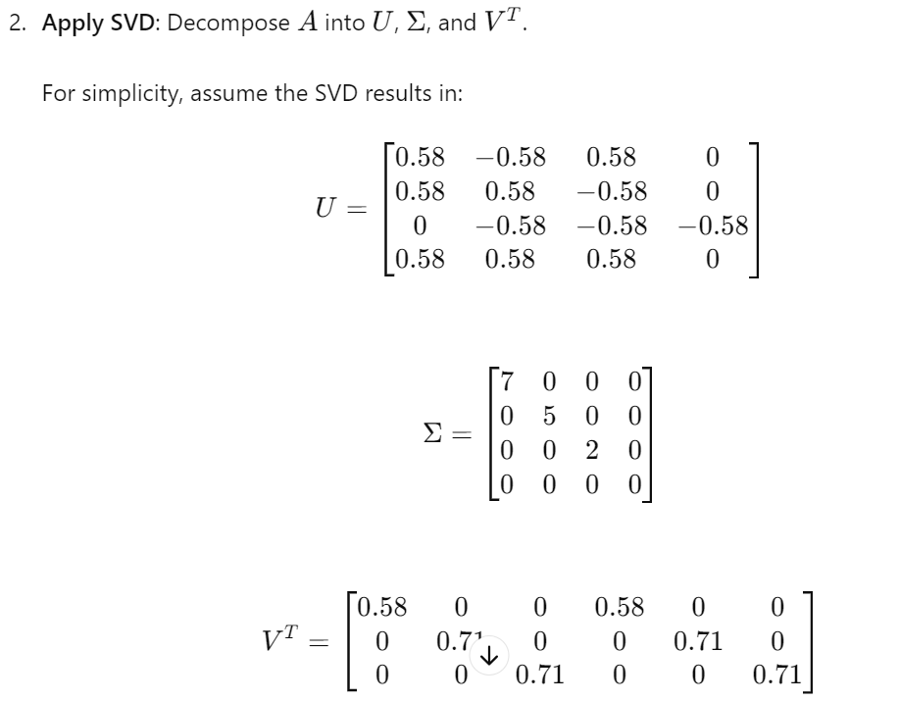
Singular Value Decomposition(SVD)

Slide 13
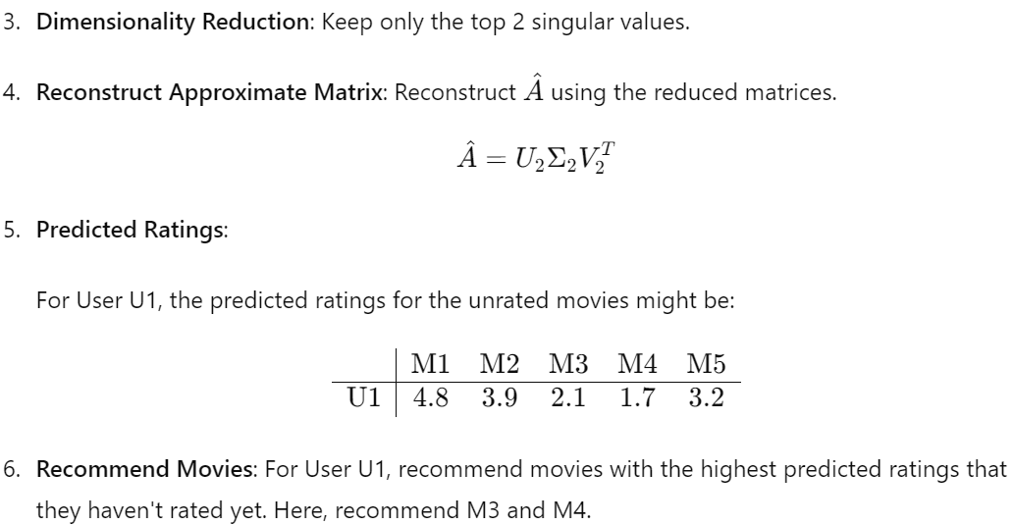
Singular Value Decomposition(SVD)

Slide 14
Hyperperameter Tuning-GridsearchCV
GridSearchCV is a scikit-learn function that performs hyperparameter tuning by training and evaluating a machine-learning model using different combinations of hyperparameters. The best set of hyperparameters is then selected based on a specified performance metric.

Slide 15
Hyperperameter Tuning-GridsearchCV
How does GridSearchCV work?
GridSearchCV works by defining a grid of hyperparameters and then systematically training and evaluating a machine learning model for each hyperparameter combination. The process of training and evaluating the model for each combination is called cross-validation. The best set of hyperparameters is then selected based on the performance metric.
To use GridSearchCV, you need to specify the following:
The hyperparameters to be tuned: This includes specifying a range of values for each hyperparameter.

Slide 16
Hyperperameter Tuning-GridsearchCV
The machine learning model: This includes the type of model you want to use and its parameters.
The performance metric to be used: This is the metric that will be used to evaluate the performance of the different hyperparameter combinations.

